Slide 1

Quality Assessment for Local Banking Apps
Al Rajhi Bank

Slide 2
Student’s Name | Student’s E-mail
Areej Turky Alotaibi | atsalotaibi03@sm.imamu.edu.sa
Raghad Adel Alshabana | raaalshabana@sm.imamu.edu.sa
Slima Mohammed bnous | smbjlal@sm.imamu.edu.sa
Shoroog Saad Alarifi | sssalarifi@sm.imamu.edu.sa
Supervisor: Lamees Alhazzaa

Slide 3
OUTLINES
Introduction
The purpose
The goals
Methodology
Discussions
Manual Analysis Result
Conclusion
References

Slide 4
FIGURE | ON TOPIC
FIGURE 1 | Methodology of Extracting the MobSF
FIGURE 2 | Methodology of Extracting the PMD
FIGURE 3 | Methodology of Extracting the PMD
FIGURE 4 | Methodology of Extracting the Check style
FIGURE 5 | MobSF Analysis Result
FIGURE 6 | MobSF Analysis Result
FIGURE 7 | MobSF Analysis Result
FIGURE 8 | Formatting
FIGURE 9 | Comments
FIGURE 10 | Comments
FIGURE 11 | Security
FIGURE 12 | Security
FIGURE 13 | Small
FIGURE 14 | Single Responsibility Principle
FIGURE 15 | Using Descriptive names
FIGURE 16 | Function Arguments
TABEL OF FIGURES

Slide 5
Introduction

Slide 6
The purpose
Improving the code
Improving the programmers

Slide 7
The goals

Slide 8
Methodology
Methodology of Extracting the Source Code
The decision of choosing Al-Rajhi Bank was not Random. After downloading all four apps, we use “APK Extractor” as an Android application then use “Online APK Decompiler”; The Source Code and all other components are clearly defined to us. One of our priorities as a team in choosing an app is that the app must be written in Java language so that Alinma bank was ignored (written in Kotlin). After observing classes and methods, the choice was made up to Al-Rajhi Bank, since some issues were clear to us early.

Slide 9
Methodology
Methodology of Extracting the MobSF
We used a Mobile Security Framework tool for several reasons, including that it is all-in-one and supports uploading APK files, and provides an easy interface for the results, so it was a good choice to evaluate the security of the application after the tool was installed, the APK file of the Al Rajhi application was uploaded then the interface appeared, We focused on the highest-risk security findings also extract some scores related with the overall result, and analyzes discussed in below.

Slide 10
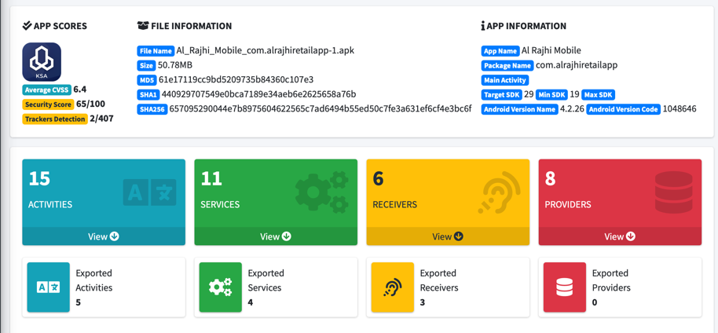
Methodology of Extracting the MobSF
FIGURE 1

Slide 11
Methodology
Methodology of Extracting the PMD
PMD (Programming Mistake Detector) is an open source static source code analyzer that reports on issues found within application code .It can analyze files written in Java, JavaScript, Apex and Visualforce, PLSQL, Apache Velocity, XML, and XSL .
It is added to the Eclipse IDE as a new software that is easy to deal with, as well as a clear display of errors, distinguishing them in color according to the severity of the risks, and describing each problem with its explanation and ways to solve it.

Slide 12
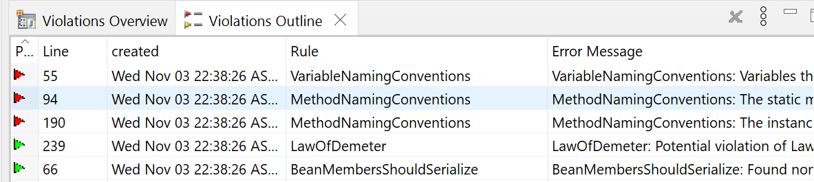
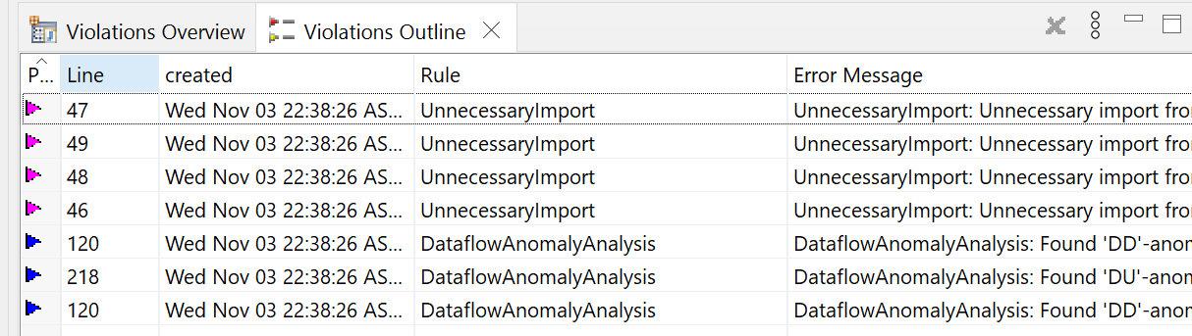
Methodology of Extracting the PMD
FIGURE 2
FIGURE 3

Slide 13
Methodology
Methodology of Extracting the Check style
Checkstyle is a development tool to help programmers write Java code that adheres to a coding standard. It automates the process of checking Java code to spare humans of this boring (but important) task. This makes it ideal for projects that want to enforce a coding standard.
Alternative to the Eclipse-CS plugin. It was used because it allows using of custom checks directly without providing an Eclipse Fragment plugin for that purpose.
It also features Checkstyle can check many aspects of your source code. It can find class design problems, method design problems. It also has the ability to check code layout and formatting issues.

Slide 14
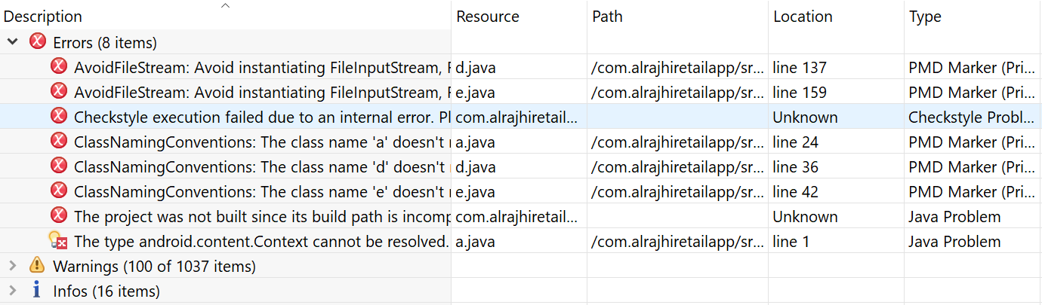
Methodology of Extracting the Check style
FIGURE 4

Slide 15
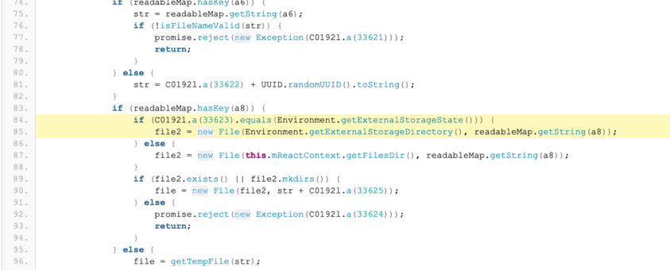
Discussions
MobSF Analysis Result :
FIGURE 5

Slide 16
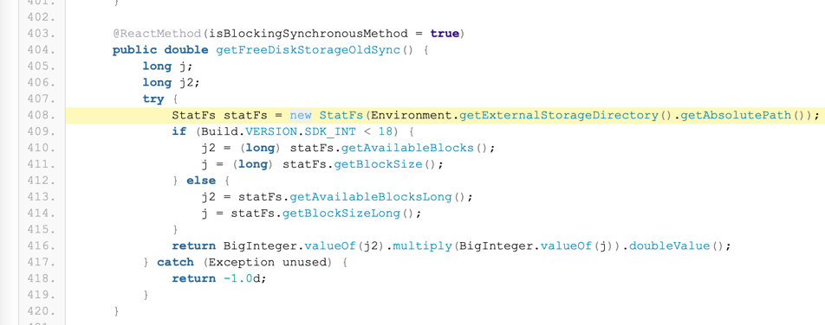
Discussions
MobSF Analysis Result :
FIGURE 6

Slide 17
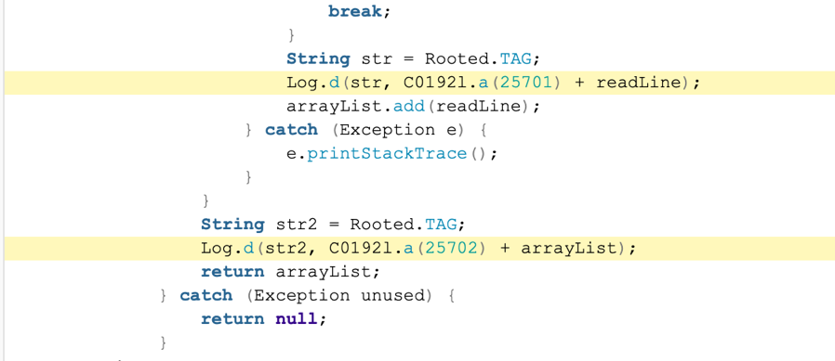
Discussions
MobSF Analysis Result :
FIGURE 7

Slide 18
PMD Analysis Result
Rule: Avoid File Stream
Rule: Class Naming Conventions
Rule: Method Naming Conventions
Rule : Data flow Anomaly Analysis
Rule : Unused Imports

Slide 19
Rule | AvoidFileStream
Category | Performance
Priority | HIGH |  |  | severity | Error
Massage | Avoid instantiating FileInputStream, FileOutputStream, FileReader, or FileWriter
Description | The FileReader and FileWriter constructors instantiate FileInputStream and FileOutputStream, again causing garbage collection issues while finalizer methods are called.
Path | com.alrajhiretailapp/src/java/cl/json
 | d.java | Line | line 137
On element | e.java |  | line 159
example | // these instantiations cause garbage collection pauses, even if properly closed FileInputStream fis = new FileInputStream(fileName); // the following instantiations help prevent Garbage Collection pauses, no finalization try(InputStream is = Files.newInputStream(Paths.get(fileName))) { }

Slide 20
Check style Analysis Result
Type: incorrect indentation
Type: Formatting
severity | Warning |  |  |  | tool | Check style
rule |  | Vertical Openness Between Concepts
 |  | Horizontal Alignment
Path | com.alrajhiretailapp/src/java
On element | Almost all classes |  | Description | Not adjusting horizontal alignment and vertical line spacing

Slide 21
Manual Analysis Result

Slide 22
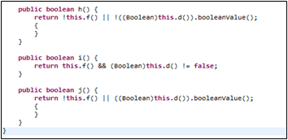
Formatting
standard code structure
following the usual standard code structure helps you read the code smoothly without any confusion or misunderstanding about missing brackets or semicolons.
there is a class we had a lack of understanding about the unstandardized structure of curly brackets that were open and closed without any function in between simply like this "{ }" or with separated lines
the main question is does it a good practice? the existing of those curly brackets did not add any benefit indeed it is added inconsistent and nonstandard style so it is not a good practice , the last thing we want to do is add unnecessary structure that may distract us .
FIGURE 8

Slide 23
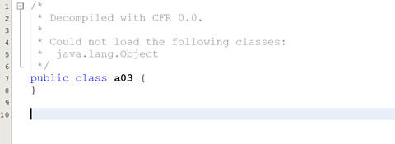
Comments
In alrajhi's code we notice number of classes with whole empty content not even a small code, what makes things worst that it was not supported by any kind of comments or description to explain the intent behind the decision of the emptiness in those classes
FIGURE 9
Even though the classes that have content were not supported by any comments , alrajhi's code was poor for explain the methods functionality according to the function's name ,variables name…etc

Slide 24
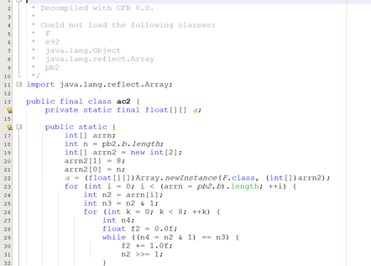
Comments
Therefore, should work on the clearness of their code with few comments Rather than spend your time writing the comments that explain the mess you have made.
FIGURE 10

Slide 25
Security
In security we extract the data from MobFs tool .
As for the percentages of the scores that appeared, they are
FIGURE 11

Slide 26
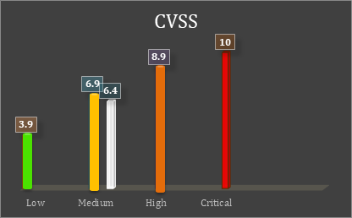

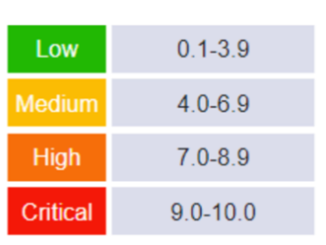
Security
in high-risk permission , the protection level of the permission should be checked.
Also we found most of them do not always have to be available so we recommended to be by default off , and just when we need to any data from these permission at this point we will request to share it .
ex: access location
in high-risk issues, and it was interesting to have a banking app
And it was related to
definition of Activities , shared some services ,
also Clear text traffic Insertion of Sensitive Information.
FIGURE 12

Slide 27
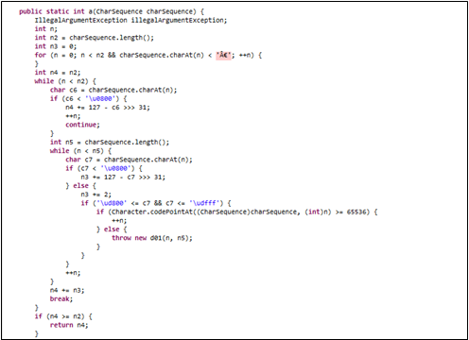
Functions
Small !
The first rule of functions is that they should be small. The Second rule of functions is that they should be smaller than that
The measurement:
Robert C. Martin agrees that 4 is a maximum nom. Of line
Suggestions:
FIGURE 13

Slide 28
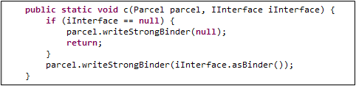
Single Responsibility Principle
FUNCTIONS SHOULD DO ONE THING. THEY SHOULD DO IT WELL. THEY SHOULD DO IT ONLY.
*A huge and solid design principle that encourage classes/methods to do one thing.
FIGURE 14
One Level of abstraction”
How it could be achieved?
Has it been achieved?
Suggestions :

Slide 29
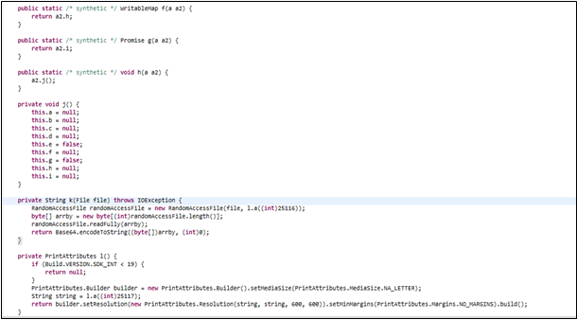
Using Descriptive names
You know you are working on clean code when each routine turns out to be pretty much what you expected.” Half the battle to achieving that principle is choosing good names for small functions that do one thing
Suggestions:
FIGURE 15

Slide 30
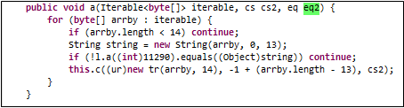
Function Arguments
Ideal argument” What does it mean?
Has it been achieved?
What’s wrong with this argument?
FIGURE 16
Suggestions:

Slide 31
Proper Data Structure
Using proper data structure will minimize Nom. Of line in the code, less time and space complexity and provide more methods to use.

Slide 32
Conclusion
This report showed an evaluation of the quality of Al-Rajhi application from many aspects, including security and code analysis, and we discussed our point of view as software engineers and several recommendations that we believe will benefit developers and software engineers according to the observation we had regardless of the criticisms that we mentioned above in this evaluation that it lacks in the basics in every aspect
In conclusion, we have noticed that the application is acceptable in normal use, as mentioned in the introduction, the approximate number of AlRajhi app is a sufficient number to bet on it.
Even it has a very good aspect beyond our humble review, we look forward to our evaluation and recommendations being the beginning of a change in its quality and development.
As a group, for future work, we may look for more tools for a single attribute for more accuracy.

Slide 33
References
[1] https://enos.itcollege.ee/~jpoial/oop/naited/Clean%20Code.pdf
[2] https://play.google.com/store/apps/details?id=com.ext.ui
[3] http://www.javadecompilers.com/
[4] https://github.com/MobSF/Mobile-Security-Framework-MobSF
[5] https://pmd.github.io/latest/pmd_rules_java_performance.html#avoidfilestream
[6] https://sourceforge.net/projects/pmd/files/pmd-eclipse/update-site/
[7] https://en.wikipedia.org/wiki/PMD_(software)
[8] https://dl.bintray.com/pmd/pmd-eclipse-plugin/updates/
[9] https://checkstyle.sourceforge.io/
[10] https://www.banksa.com.au/online-services/mobile-banking/app-permissions
[11] https://medium.com/android-news/android-activity-launch-mode-e0df1aa72242
[12] http://www.androidtutorialshub.com/cleartext-http-traffic-not-permitted/
[13] https://ar.wikipedia.org/wiki/نظام_تسجيل_نقاط_الضعف_المشترك
[14] https://docs.oracle.com/javase/7/docs/api/java/io/FileInputStream.html
[15] http://en.wikipedia.org/wiki/Single_responsibility_principle

